Slide 1

COMET Techniques
Aruna S
Department of
Computer Science and Engineering

Slide 2

COMET TECHNIQUES
LONG POLLING
S. Aruna
Department of Computer Science and Engineering

Slide 3
COMET TECHNIQUES
Comet is a web application model in which a long-held HTTPS request allows a web server to push data to a browser
COMET makes a single and regular HTTPS request.
Never ending response from the server
Browser keeps the connection open and waits for new data. Whenever new data arrives the server will write that to the response stream.
Various names Ajax Push, Reverse Ajax,Two-way-web, HTTP Streaming and HTTP server push

Slide 4
COMET TECHNIQUES
Specific methods of implementing Comet fall into two major categories:
Streaming
Long polling
Techniques for streaming Comet are-
Hidden iframe
XMLHttpRequest
Techniques for Long Polling Comet are-
XMLHttpRequest long polling
Script tag long polling

Slide 5
COMET TECHNIQUES
Long Polling
A more efficient form of the original polling technique.
Repeated requests to a server wastes resources.
Wait until new data for a given client becomes available
The server elects to hold a client’s connection open for as long as possible, delivering a response only after data becomes available or a timeout threshold is reached.
The server allows approximately 6 parallel connections from the browser

Slide 6
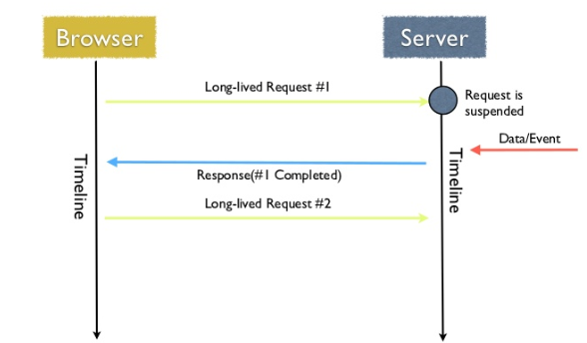
COMET TECHNIQUES
Long Polling

Slide 7
COMET TECHNIQUES
Long Polling Considerations
As usage grows, how will you orchestrate your realtime backend?
When mobile devices rapidly switch between WiFi and cellular networks or lose connections, and the IP address changes, does long polling automatically re-establish connections?
With long polling, can you manage the message queue and catch up missed messages?
Does long polling provide load balancing or failover support across multiple servers?
When building a realtime application with HTTP long polling for server push, you’ll have to develop your own communication management system. This means that you’ll be responsible for updating, maintaining, and scaling your backend infrastructure.

Slide 8
COMET TECHNIQUES
Long Polling Pros and Cons
PROS
Implemented on the back of XMLHttpRequest
A server can be queried for new data which does not support long polling - can be implemented using XMLHttpRequest, or via JSONP through simple HTML script tags.
CONS
Long polling is a lot more intensive on the server.
Reliable Message Ordering can be an issue.
Confirmation of message receipt by one client instance may also cause another client instance to never receive an expected message at all

Slide 9
THANK YOU
Aruna S
Department of
Computer Science and Engineering
arunas@pes.edu

